Slide 1
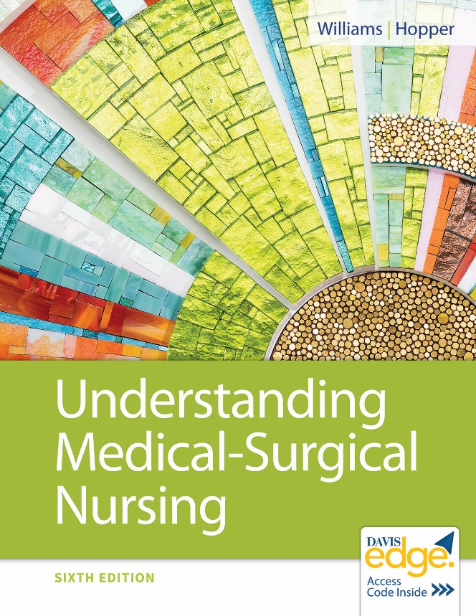
Chapter 19
Nursing Care of Patients with Immune Disorders

Slide 2
Learning Outcomes
Explain the immunological mechanism for the four types of hypersensitivities.
Explain the pathophysiology of disorders of the immune system.
Identify the etiologies, signs, and symptoms of immune system disorders.
Plan nursing care for patients undergoing tests for immune system disorders.
Describe current medical treatment for immune system disorders.

Slide 3
Learning Outcomes (continued)
List data collected when caring for patients with disorders of the immune system.
Explain factors that alter or influence the self-recognition portion of the immune system.
Plan nursing care for patients with disorders of the immune system.
Evaluate effectiveness of nursing interventions.

Slide 4
Disorders of the Immune System
Three categories
Hypersensitivity reactions
Autoimmune disorders
Immune deficiencies

Slide 5
Disorders of the Immune System (continued_1)
Hypersensitivity reactions
Anaphylaxis
Hemolytic transfusion reactions
Measles
Transplant rejections

Slide 6
Disorders of the Immune System (continued_2)
Autoimmune disorders
Rheumatoid arthritis
Ulcerative colitis
Multiple sclerosis

Slide 7
Disorders of the Immune System (continued_3)
Immune deficiencies
Hypogammaglobulinemia
Acquired immunodeficiency syndrome (AIDS)

Slide 8
Hypersensitivity Reactions
Injury to body due to exaggerated response
Classified by way tissue is injured
Type 1, 2, 3, 4

Slide 9
Type 1 Hypersensitivity Reaction
Anaphylactic reaction
Occurs immediately
Mild to severe, life-threatening

Slide 10
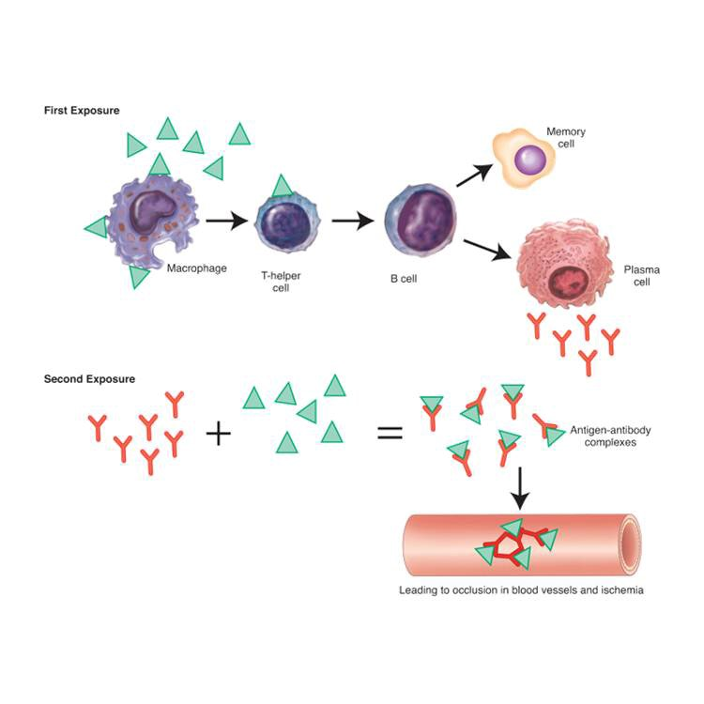
Type 1 Hypersensitivity Reaction (continued)

Slide 11
Allergic Rhinitis
Most common form of allergy
Sneezing; nasal itching; runny nose; itchy, red eyes

Slide 12
Atopic Dermatitis
Often called eczema
Inflammatory skin response
Pruritus, edema, extremely dry skin, blisters, crusts, scales

Slide 13
Anaphylaxis
Severe systemic type 1 reaction
Widespread histamine release
Bronchial narrowing: Stridor, wheezing, respiratory arrest
Hypotension, tachycardia, cardiac arrest

Slide 14
Anaphylaxis (continued)
Immediate treatment guided by symptoms
Oxygen
Epinephrine
Antihistamines
Corticosteroids
Vasopressors
Mechanical ventilation
Nursing care
Early recognition
Maintain airway
Emotional support
Education

Slide 15
Urticaria (Hives)
Release of histamine
Raised, pruritic, nontender, erythematous wheals on skin
Therapeutic interventions
Epinephrine
Corticosteroids
Antihistamines
Histamine H₂ blockers

Slide 16
Angioedema
Form of urticaria
Affects submucosal/subcutaneous tissue rather than skin
Painless, dermal erythematous/ subcutaneous eruptions, skin/mucous membrane edema

Slide 17
Nursing Diagnoses
Impaired Gas Exchange
Anxiety
Risk for Impaired Skin Integrity
Ineffective Health Maintenance

Slide 18
Nursing Care
Monitor respiratory status.
Monitor level of consciousness.
Stay with patient.
Provide information.
Note and document skin and lesions.
Teach rubbing or pressure, not scratching.
Teach patient to wear medical identification.
Discuss methods of avoiding allergen.

Slide 19
Type 2 Hypersensitivity Reaction
Destruction of substance with antigen
May be beneficial (bacteria)
Not beneficial when red blood cell (R B C) sensed as foreign

Slide 20
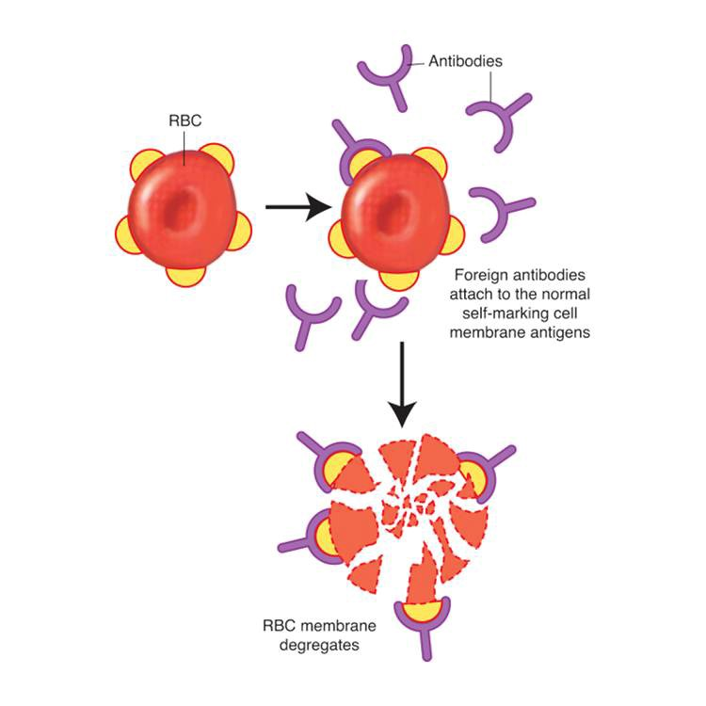
Type 2 Hypersensitivity Reaction (continued)

Slide 21
Hemolytic Transfusion Reaction
RBC’s with foreign antigens rapidly lysed
Occludes blood vessels
Ischemia, necrosis
Life-threatening
Prevention is key!
Rhogam: Rho(D) negative patients
Careful blood transfusion administration

Slide 22
Hemolytic Transfusion Reaction (continued_1)
Therapeutic interventions
Antihistamines
Corticosteroids
Sympathomimetics
Nursing diagnoses
Fear
Ineffective Tissue Perfusion
Risk for Injury
Deficient Knowledge

Slide 23
Hemolytic Transfusion Reaction (continued_2)
Nursing care
Prevention
Careful transfusion monitoring
If reaction, stop blood, follow policy
Education

Slide 24
Type 3 Hypersensitivity Reaction
Immune complexes formed by antigens and antibodies
Antigen-antibody complexes within blood vessels
Enzymes lead to blood vessel damage
Red edematous lesion, bleeding, necrosis

Slide 25
Type 3 Hypersensitivity Reaction (continued)

Slide 26
Serum Sickness
Antigen–antibody complexes cause symptoms of inflammation
7 to 10 days after penicillin/sulfonamide
Severe urticaria and angioedema
Brief and self-limiting condition

Slide 27
Serum Sickness (continued)
Nursing diagnoses
Acute Pain
Risk for Deficient Fluid Volume
Nursing care
Monitoring of symptoms
Evaluation of medication effects
Education

Slide 28
Type 4 Hypersensitivity Reaction
Delayed reaction
Sensitized T lymphocyte contacts antigen
Cell-mediated immune response
Necrosis

Slide 29
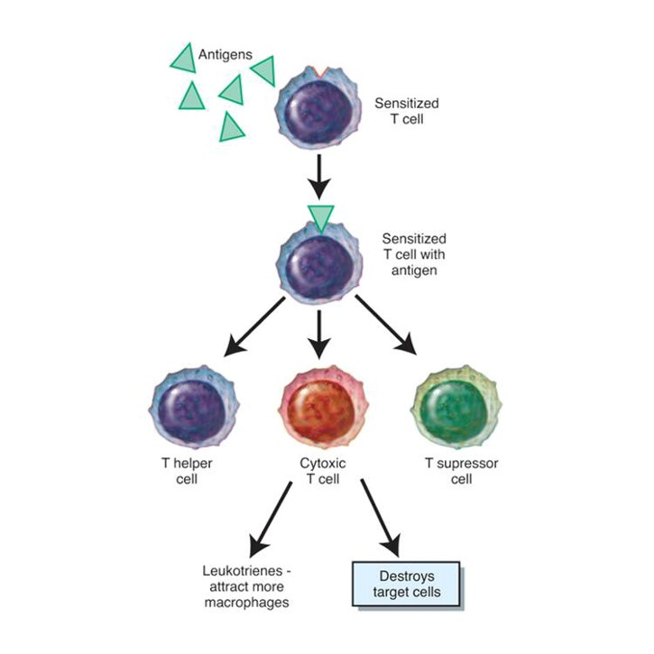
Type 4 Hypersensitivity Reaction (continued)

Slide 30
Contact Dermatitis
Chemical comes in contact with skin
On second exposure, T cells secrete chemicals
Poison ivy, poison oak, latex rubber
Reddened, pruritic, fragile vesicles

Slide 31
Contact Dermatitis (continued)
Therapeutic interventions
Use antihistamines, topical drying agents, corticosteroids.
Take tepid baking soda baths or Aveeno baths.
Wash with brown soap (Fels-Naptha).
Avoid scratching skin.

Slide 32
Transplant Rejection
Transplanted living tissue sensed as foreign
Lymphocytes sensitized immediately
Invade transplanted tissue and destroy it
Failure of organ or tissue
Infection can result in death
Prevention
Immunosuppression therapy

Slide 33
Autoimmune Disorders
Immune system recognizes body’s own cells as foreign
Immune response destroys cells

Slide 34
Pernicious Anemia
Antibodies against gastric parietal cells and intrinsic factor
Vitamin B₁₂ deficiency
RBC production decreased
Also caused by gastric or small bowel resections
Therapeutic interventions
Corticosteroids
Lifelong vitamin B₁₂

Slide 35
Idiopathic Autoimmune Hemolytic Anemia
Autoantibodies attach to RBC’s
Lyse or agglutinate
Signs and symptoms
Mild fatigue
Pallor
Hypotension
Dyspnea
Jaundice

Slide 36
Idiopathic Autoimmune Hemolytic Anemia (continued)
Therapeutic interventions
Immunosuppressive medications
Oxygen
Corticosteroids
Folic acid
Transfusion
Erythrocytapheresis
Splenectomy

Slide 37
Hashimoto’s Thyroiditis
Autoantibodies for thyroid-stimulating hormone, thyroid gland overstimulation
Then autoantibodies destroy thyroid, hypothyroidism
Lifelong thyroxine

Slide 38
Lupus Erythematosus
Three types
Discoid lupus erythematosus (DLE)
Skin lesions
Drug-induced systemic lupus erythematosus (DILE)
After certain medication use
Systemic lupus erythematosus (SLE)
Chronic, inflammatory, multisystem disorder

Slide 39
Lupus Erythematosus: Signs and Symptoms
DLE
Patchy, crusty, sharply defined skin plaques
Occur on face/sun-exposed areas
DILE
Pleuropericardial inflammation
Fever
Rash
Arthritis

Slide 40
Systemic Lupus Erythematosus (S L E)
Etiology
Young women of childbearing years
First-degree relatives of lupus patients
African American/Hispanic population more likely to develop frequently

Slide 41
Systemic Lupus Erythematosus (SLE) (continued_1)
Signs and symptoms
Early symptoms vague: Fatigue, fever
Dermatological: Butterfly rash, bruising photosensitivity, alopecia, pain, pruritis
Musculoskeletal: Arthralgia, arthritis
Hematological: Anemia, leukocytopenia, thrombocytopenia
Cardiopulmonary: Pericarditis, myocarditis, myocardial infarction, vasculitis, pleurisy, valvular disease

Slide 42
Systemic Lupus Erythematosus (SLE) (continued_2)
Signs and symptoms (continued)
Renal: Kidney disease, urinary tract infections, fluid and electrolyte imbalances
Central nervous system: Cranial neuropathies, seizures, cognitive impairment
Gastrointestinal: Anorexia, ascites, pancreatitis, intestinal vasculitis
Ophthalmological: Conjunctivitis, dry eyes, glaucoma, cataracts, retinal pigmentation

Slide 43
Systemic Lupus Erythematosus (SLE) (continued_3)
Therapeutic interventions
Symptomatic management
NSAID’s
Immunosuppressants
Corticosteroids
Antimalarials
IV immunoglobulin

Slide 44
Systemic Lupus Erythematosus (S L E) (continued_4)
Complications
Osteonecrosis
Kidney disease
Thrombocytopenia
Emboli
Myocarditis
Vasculitis
Mesenteric or intestinal vasculitis
Sepsis

Slide 45
Systemic Lupus Erythematosus (SLE) (continued_5)
Nursing diagnoses
Acute Pain
Disturbed Body Image
Fatigue
Ineffective Health Maintenance

Slide 46
Ankylosing Spondylitis
Chronic progressive inflammatory disease
Sacroiliac, costovertebral, large peripheral joints
Signs and symptoms
Lower back stiffness
Pain
Lordosis, kyphosis
Spasms
Fatigue
Anorexia, weight loss

Slide 47
Ankylosing Spondylitis (continued)
No cure, supportive care, surgery
Education: Range-of-motion frequently
Nursing diagnoses
Chronic Pain
Powerlessness
Fatigue
Self-Care Deficit
Impaired Physical Mobility

Slide 48
Immune Deficiencies
One or more components of the immune system is completely absent or deficient.

Slide 49
Hypogammaglobulinemia
Absence/deficiency of one or more of five immunoglobulins from defective B cell function
Prone to infections
Therapeutic interventions
Minimizing infections
IgG injections
Fresh frozen plasma

Slide 50
Review Question
Which of these are the three categories of immune disorders? Select all that apply.
Hypersensitivity reactions
Autoimmune disorders
Immune deficiencies
Arthritis
Anemia

Slide 51
Review Question Answer
Correct Answer: 1, 2, 3

Slide 52
Review Question (continued_1)
The nurse is observing a patient who is receiving an antibiotic. Which of these would the nurse recognize as signs of anaphylaxis? Select all that apply.
Stridor
Wheezing
Respiratory arrest
Hypertension
Bradycardia

Slide 53
Review Question Answer (continued_1)
Correct Answer: 1, 2, 3

Slide 54
Review Question (continued_2)
Which of these would the nurse anticipate would be ordered for a patient experiencing anaphylaxis? Select all that apply.
Oxygen
Epinephrine
Insulin
Antihistamines
Corticosteroids
Mechanical ventilation

Slide 55
Review Question Answer (continued_2)
Correct Answer: 1, 2, 4, 5, 6

Slide 56
Review Question (continued_3)
Which of these nursing interventions would the nurse implement for a type I hypersensitivity reaction? Select all that apply.
Monitor respiratory status.
Monitor level of consciousness.
Place the patient in isolation.
Provide information.
Teach to avoid rubbing or applying pressure for itching.

Slide 57
Review Question Answer (continued_3)
Correct Answer: 1, 2, 4

